Slide 1
Generative Deep Learning

Slide 2
Generative AI
Exploring Deep Learning in Artistic Augmentation
Reviewing sequence data generation for text or music.
Exploring DeepDream, variational autoencoders, and generative adversarial networks for image creation.
Enabling computers to generate unprecedented content.
Encouraging the audience to dream about the fantastic intersection of technology and art.
Inviting everyone to join in and begin the exploration of deep learning's impact on artistic expression.

Slide 3
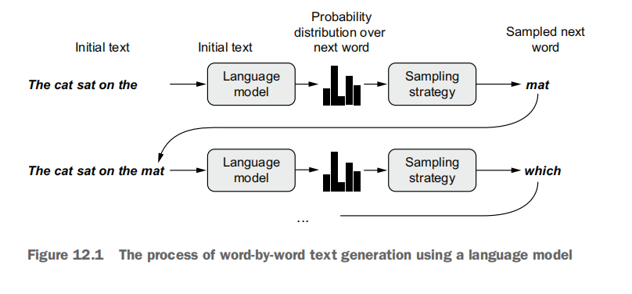
A Basic Language Model (Sequence Generation)

Slide 4
Sequence Generation
The text you provided explains the process of generating sequence data in deep learning, particularly focusing on text generation. Here's a summary:
### Sequence Data Generation in Deep Learning
- **Universal Approach**: The common method to generate sequence data involves training a model, often a Transformer or an RNN (Recurrent Neural Network), to predict the next token or tokens in a sequence based on the previous tokens.
- **Language Model**: The model is referred to as a language model, which can be based on words or characters. It captures the statistical structure, or the latent space, of language.
- **Sampling from the Model**: After training the language model, you can sample from it to generate new sequences. This involves feeding an initial string of text (conditioning data), asking the model to generate the next token, adding the generated output back to the input data, and repeating the process.
### Importance of Sampling Strategy
- **Greedy Sampling**: The naive approach involves always choosing the most likely next character. However, this can result in repetitive and predictable strings that lack coherence.
- **Stochastic Sampling**: A more interesting approach introduces randomness by sampling from the probability distribution for the next character. This allows for more surprising choices and creativity in the generated text.
- **Softmax Temperature**: Controlling the amount of randomness is crucial. The softmax temperature is introduced as a parameter that characterizes the entropy of the probability distribution used for sampling. It allows you to adjust the level of randomness in the generation process.
### Balancing Randomness
- **Entropy and Randomness**: The text discusses the concept of entropy, with maximum entropy resulting in pure random sampling and minimum entropy in greedy sampling. Intermediate points between these extremes offer a balance between predictability and creativity in generated sequences.
- **Exploring Different Amounts of Randomness**: Since the perceived interestingness of generated data is subjective, it's recommended to explore different levels of randomness during the sampling process.
In summary, the process involves training a language model, sampling from it using a suitable strategy (potentially with variable temperature), and finding a balance between predictability and creativity in the generated sequences.

Slide 5
Text Generation with Deep Learning
Objective:
- Explore text generation using recurrent neural networks (RNNs) and deep learning techniques.
Sequence Data Generation:
RNNs are applied to generate sequence data, demonstrated here with text generation.
Applicable to various sequence types, e.g., music notes, brushstroke data, speech synthesis, and chatbot dialogues.
Historical Context:
LSTM algorithm's early use in 1997 for text generation.
Evolution of recurrent networks for music and handwriting generation.
Emergence of the Transformer architecture, exemplified by GPT-3 in 2020.
Generating Sequences:
Universal method involves training a model (Transformer or RNN) to predict the next token using prior tokens.
Sampling from the model allows the generation of diverse and structured sequences.
Sampling Strategy:
Importance of choosing the next token wisely.
Introduction of softmax temperature to control the randomness in sampling.
Implementation with Keras:
Demonstration of text generation using a Transformer-based model in Keras.
Preparation of language modeling dataset and reweighting probability distributions.
Temperature in Text Generation:
Experimentation with different temperatures during text generation.
Balancing between learned structure and randomness for interesting and coherent output.
Conclusion:
Deep learning models capture statistical structures of language artifacts.
Language models generate sequences but lack intrinsic meaning or understanding.
Text generation is a powerful application of deep learning, balancing creativity and structure in generating coherent sequences.

Slide 6
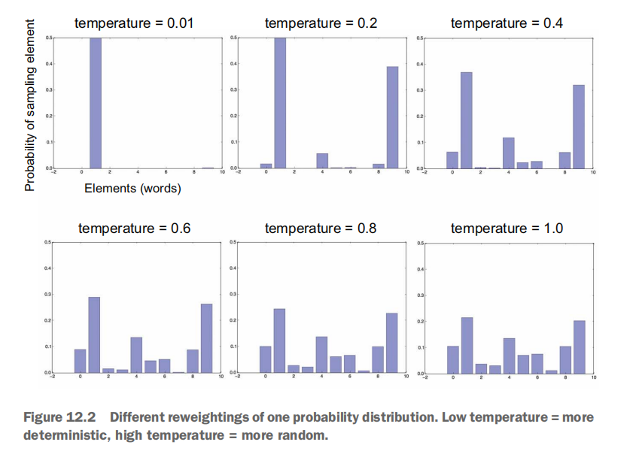
Softmax Temperature

Slide 7
Temperature Impact
Softmax Temperature in Text Generation:
In language models, the softmax function is commonly used to convert model predictions into probability distributions over the vocabulary.
The softmax function normalizes the logits (raw model outputs) into probabilities, making them sum to 1.
Effect of Temperature on Sampling:
1. **High Temperature (e.g., 1.5):**
- **Effect:** Introduces randomness and diversity.
- **Sampling Behavior:** More likely to select tokens with lower probabilities, resulting in more varied and creative text.
- **Observation:** Text becomes less constrained, and local structure breaks down.
2. **Medium Temperature (e.g., 0.7):**
- **Effect:** Balanced randomness and structure.
- **Sampling Behavior:** Strikes a balance between exploring new possibilities and adhering to learned patterns.
- **Observation:** Often considered a sweet spot for generating interesting and coherent text.
3. **Low Temperature (e.g., 0.2):**
- **Effect:** Reduces randomness, increases predictability.
- **Sampling Behavior:** Favors high-probability tokens, resulting in more focused and repetitive text.
- **Observation:** Text becomes more deterministic and follows learned patterns closely.
Practical Use in Text Generation:
1. **Choosing the Right Temperature:**
- The choice of temperature depends on the desired characteristics of the generated text.
- Experimentation is crucial to finding the optimal temperature for a given task or style.
- A balance is sought between generating diverse, creative text and maintaining coherence and relevance.
2. **Temperature during Training:**
- In the provided text generation callback, the model is sampled with different temperatures after each training epoch.
- This allows observation of how the generated text evolves during training and how the impact of temperature changes.
Understanding and experimenting with the softmax temperature is a key aspect of fine-tuning a language model for text generation to achieve the desired balance between randomness and structure.

Slide 8
Introduction to DeepDream DeepDream: A Creative Dive into Neural Network Artistry
**Idea:**
DeepDream is an imaginative image modification technique leveraging neural network representations.
**Key Points:**
Artistic Impact: Generates surreal images with algorithmic patterns.
Neural Inspiration: Inspired by disruptions in the human visual cortex, akin to psychedelic experiences.
**Example Use Cases:**
Digital Art: Popular for creating visually stunning digital artwork.
Abstract Imagery: Transforms ordinary images into abstract, dreamlike compositions.

Slide 9
DeepDream Algorithm in Keras Implementation in Keras: Unveiling the DeepDream Process
**Choosing the Model:**
Idea: Utilizing a pretrained Inception V3 model for feature extraction.
Key Points: Model choice influences the richness and complexity of generated patterns.
**Feature Extractor Model:**
Idea: Capturing activations from specific layers to guide image transformation.
Key Points: Selection of layers, such as mixed4 and mixed7, with varying weights for distinct visual outcomes.
**Computing the Loss:**
Idea: Defining a loss function to maximize the activations of chosen layers.
Key Points: Balancing the contribution of each layer for a harmonious and visually appealing result.
**Gradient Ascent Process:**
Idea: Iterative optimization process to enhance desired features in the image.
Key Points: Gradual updates to the image to avoid over-optimization and maintain image quality.
**Example Use Cases:**
Neural Art Exploration: Experimenting with different layer configurations to produce diverse artistic outputs.
Visualizing Neural Representations: Gaining insights into what features neural networks respond to.

Slide 10
DeepDream in Action The Multiscale Artistry of DeepDream
**Multiscale Processing:**
Idea: Implementing a multiscale approach to process images at different resolutions.
Key Points: Preserving details through successive octaves for a more intricate final output.
**Parameters and Configurations:**
Idea: Adjusting key parameters to influence the final visual outcome.
Key Points: Significance of step size, number of octaves, and iteration count in shaping the image.
**Results and Recommendations:**
Idea: Showcasing the impact of different layer configurations on a test image.
Key Points: Recommending exploration of diverse layer combinations for a broader range of effects.
**Practical Considerations:**
Idea: Providing practical advice for optimal results in terms of image size and ratio.
Key Points: Highlighting the quick runtime on GPU for efficient experimentation and creative exploration.
**Example Use Cases:**
Image Enhancement: Using DeepDream to enhance and transform photographs into visually compelling artworks.
Educational Tool: Demonstrating neural network behaviors and representations through visual experimentation.

Slide 11
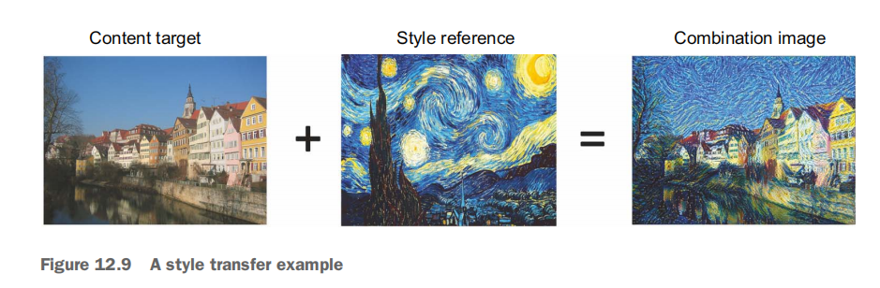

Neural style transfer

Slide 12
Neural Style Transfer Essentials
**1. Concept:**
Neural Style Transfer (NST) merges artistic style and image content.
Applying the style of one image to another while conserving content.
**2. Core Idea:**
Mathematical essence lies in defining and minimizing a specific loss function.
Deep convolutional neural networks redefine texture generation and artistic image transformation.
Balance between preserving content and embracing stylistic elements.

Slide 13
The Content Loss
**1. Understanding Content in ConvNets:**
- Activations from earlier layers: Local information.
- Activations from higher layers: Global, abstract information.
**2. Decomposition of Image Content:**
- Convnet layers provide content decomposition over spatial scales.
- Content of an image captured by representations in upper convnet layers.
**3. Content Loss Definition:**
- Utilize L2 norm between activations of upper layer (pretrained convnet).
- Compute over target image and generated image.
- Ensures similarity from upper layer perspective.
*Illustration: Visualizing the decomposition of image content through convnet layers.*

Slide 14
The Style Loss
**1. Leveraging Multiple Convnet Layers:**
- Style loss uses multiple layers to capture appearance at various scales.
**2. Gram Matrix for Style Loss:**
- Style loss by Gatys et al.: Gram matrix of layer’s activations.
- Inner product of feature maps captures correlations and spatial scale patterns.
**3. Preserving Textures Across Scales:**
- Maintain similar internal correlations across different layers.
- Guarantees shared textures at different spatial scales.
**4. Overall Objective:**
- Preserve content and style using pretrained convnet.
- Convnet sees both images containing the same elements.
*Illustration: Diagram illustrating the correlation preservation for style across layers.*

Slide 15
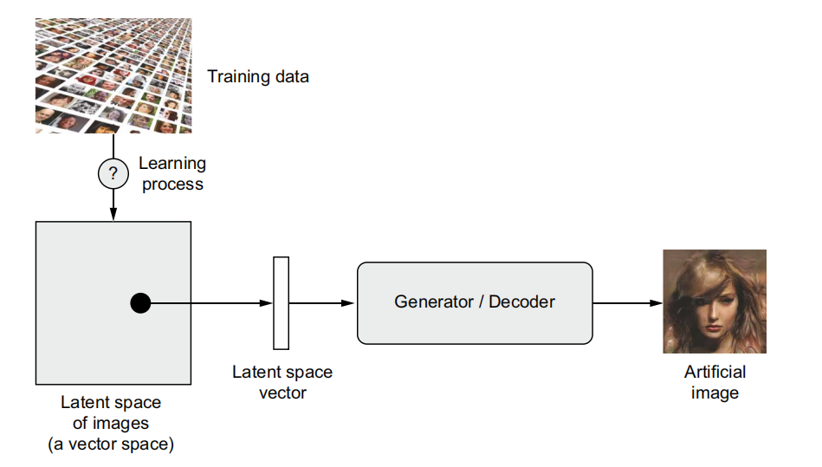
Generating images with variational autoencoders

Slide 16
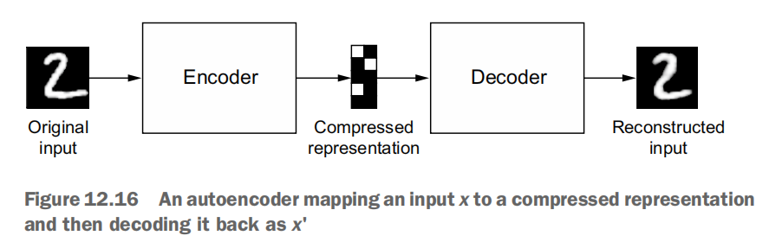
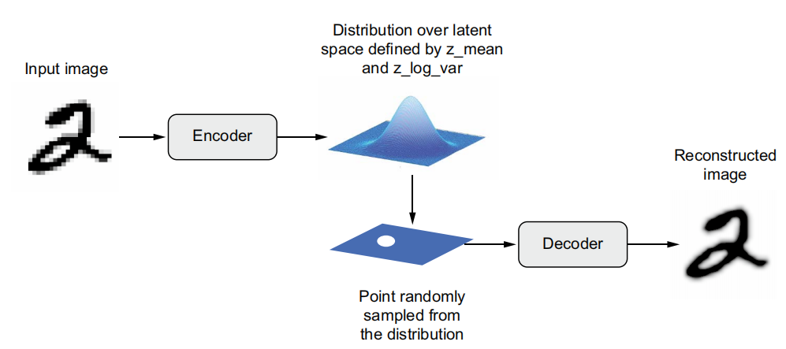
Encode-Decoder setup in VAE

Slide 17
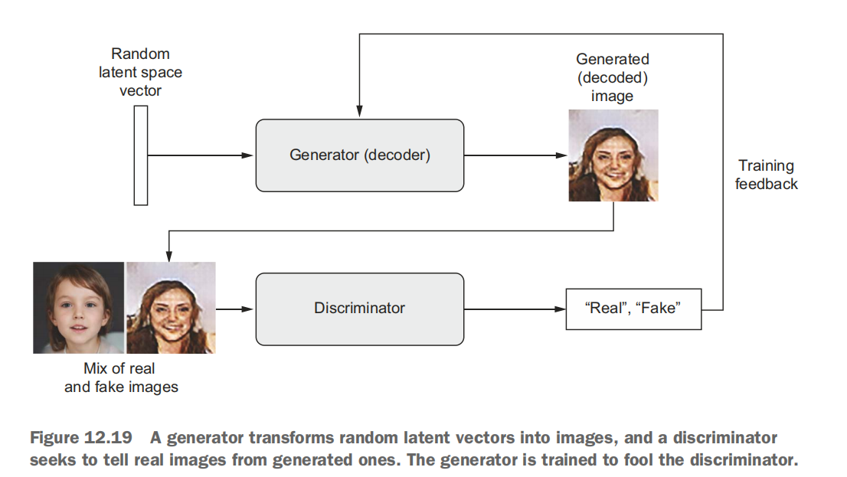
Introduction to generative adversarial networks

Slide 18
